Slide 1

Analysis and Prediction of Adult Income In US Based on Census Data Using Machine Learning
Authors
Ebony Postell
Jin Joo
Naveen Mudaliar
Nisa Bukhari
Sindhuja Kumar
Syed Rashid

Slide 2

Framework
Importing libraries & data
Data wrangling
Exploratory data analysis and data processing
Encoding categorical variable
Train + test data splitting
Machine Learning Algorithm
Logistic Regression
KNN
Decision Tree

Slide 3
Overview
This project uses the annual income data set from The US Census
Bureau to predict annual money incomes for adults, given a set of 41
employment and demographic attributes. Census money income is
defined as income received on a regular basis (exclusive of certain
money receipts).
Income levels were binned into two classes:
1) greater than 50,000 and
2) less than or equal to 50,000 (annually) in the dataset. Therefore, the
analysis and modeling was based on this classification.
The project uses Machine Learning, Python, Data Modelling, and
Tableau 10.0 for visualization.

Slide 4
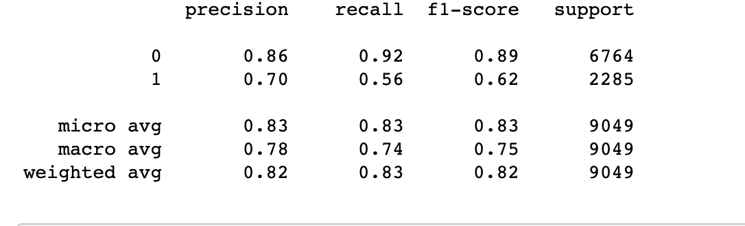
Logistic Regression
Defining the problem statement
Exploratory Data Analysis
Training the model
Fine tuning the model
Save the model

Slide 5
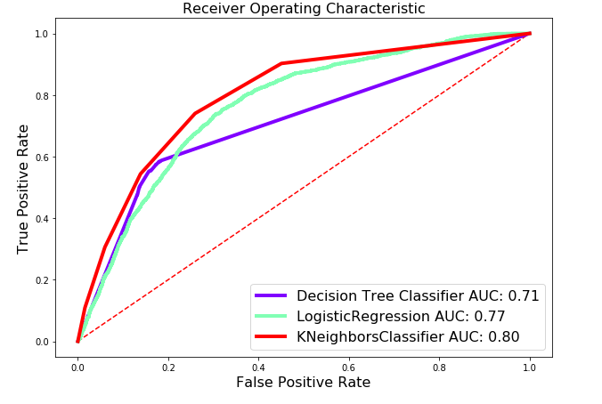
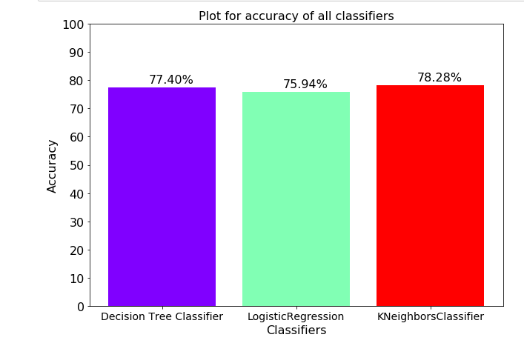
Decision Tree
KNN

Slide 6
Decision Tree
clean and prepare the data,
build a decision tree with default hyperparameters,
understand all the hyperparameters that we can tune, and finally
choose the optimal hyperparameters using grid search cross-validation.

Slide 7
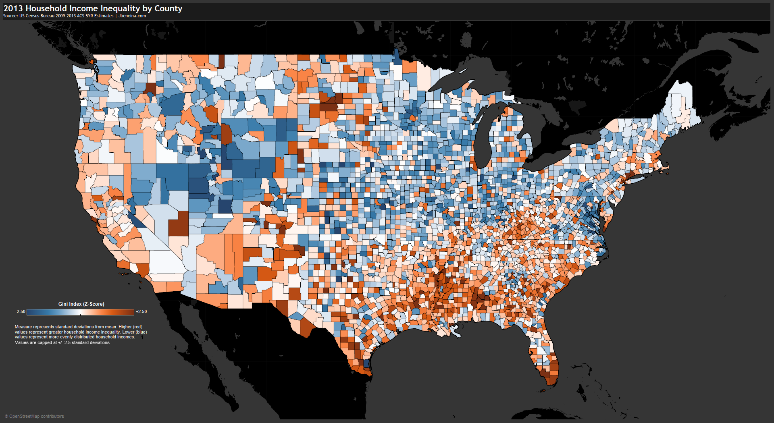

Switching to Tableau

Slide 8
Kaggle
US Census Data
Any questions

